Slide 1
Notes:
This chapter is probably the most challenging in the text, but also one of the most worthwhile.
To make it easier for students, emphasize the connections between the model’s elements and what students have learned previously. If some students feel overwhelmed by the notation, remind them that the concepts behind the notation are familiar: the IS curve, the Phillips curve, the Fisher equation, and others.

Slide 2
IN THIS CHAPTER, YOU WILL LEARN:
how to incorporate dynamics into the AD-AS model we previously studied
how to use the dynamic AD-AS model to illustrate long-run economic growth
how to use the dynamic AD-AS model to trace out the effects over time of various shocks and policy changes on output, inflation, and other endogenous variables
1

Slide 3
Introduction
The dynamic model of aggregate demand and aggregate supply gives us more insight into how the economy works in the short run.
It is a simplified version of a DSGE model, used in cutting-edge macroeconomic research.
(DSGE = Dynamic, Stochastic, General Equilibrium)

Slide 4
Introduction
The dynamic model of aggregate demand and aggregate supply is built from familiar concepts, such as:
the IS curve, which negatively relates the real interest rate and demand for goods & services
the Phillips curve, which relates inflation to the gap between output and its natural level, expected inflation, and supply shocks
adaptive expectations, a simple model of inflation expectations

Slide 5
How the dynamic AD-AS model is different from the standard model
Instead of fixing the money supply, the central bank follows a monetary policy rule that adjusts interest rates when output or inflation change.
The vertical axis of the DAD-DAS diagram measures the inflation rate, not the price level.
Subsequent time periods are linked together: Changes in inflation in one period alter expectations of future inflation, which changes aggregate supply in future periods, which further alters inflation and inflation expectations.

Slide 6
Keeping track of time
The subscript “t ” denotes the time period, e.g.
Y_{t} = real GDP in period t
Y_{t -1} = real GDP in period t – 1
Y_{t +1} = real GDP in period t + 1
We can think of time periods as years. E.g., if t = 2010, then
Y_{t} = Y₂₀₁₀ = real GDP in 2010
Y_{t -1} = Y₂₀₀₉ = real GDP in 2009
Y_{t +1} = Y₂₀₁₁ = real GDP in 2011
Notes:
You may wish to delete the second half of the slide and give your students the information orally.

Slide 7
The model’s elements
The model has five equations and five endogenous variables: output, inflation, the real interest rate, the nominal interest rate, and expected inflation.
The equations may use different notation, but they are conceptually similar to things you’ve already learned.
The first equation is for output…

Slide 8
Output: The Demand for Goods and Services
output
natural level of output
real interest rate
Negative relation between output and interest rate, same intuition as IS curve.
Notes:
The demand for goods and services is negatively related to the real interest rate, just as with the IS curve: a higher interest rate reduces investment (and the interest-sensitive portion of consumption, if you’re modeling consumption and saving as functions of the interest rate), and therefore reduces income.
This equation also shows that the demand for goods and services is higher when the natural rate of output is higher.
The following slide explains the parameters (alpha and rho) and the demand shock.

Slide 9
Output: The Demand for Goods and Services
demand shock, random and zero on average
measures the interest-rate sensitivity of demand
“Natural rate of interest.” In absence of demand shocks,
when
Notes:
You might explain the demand shock term as follows: When epsilon is zero, as it is on average, demand is determined by its “fundamentals,” the real interest rate and the natural rate of output. When epsilon > 0, demand is higher than the level implied by its fundamentals. This would occur, for example, if consumers or businesses were unusually optimistic. When epsilon < 0, demand is lower than implied by the fundamental determinants of demand. This might represent pessimistic consumers or business firms.
(Caution: the preceding use of the term “fundamentals” is not in the textbook.)
Alpha is a positive parameter that reflects the sensitivity of aggregate demand to changes in the interest rate. A given change in the real interest rate has a bigger effect on output if alpha is large than if it is small.
Rho can be thought of as the “natural rate of interest,” the interest rate that, in absence of demand shocks, would prevail when output equals its natural level. To keep the model from becoming too complicated, we take rho to be an exogenous constant term.

Slide 10
The Real Interest Rate: The Fisher Equation
ex ante (i.e. expected) real interest rate
nominal interest rate
expected inflation rate
increase in price level from period t to t +1, not known in period t
expectation, formed in period t, of inflation from t to t +1
Notes:
The Fisher equation, familiar from Chapter 4, states that the nominal interest rate equals the real interest rate plus the inflation rate.
The equation on this slide is obtained by solving the Fisher equation for the real interest rate, and using the expected (rather than actual/realized) inflation rate to determine the ex ante (rather than ex post) real interest rate.
Thus, the real return savers expect to earn on their loans, and the real cost borrowers expect to pay on their debts, is the nominal interest rate minus the inflation rate people expect.

Slide 11
Inflation: The Phillips Curve
current inflation
previously expected inflation
supply shock, random and zero on average
indicates how much inflation responds when output fluctuates around its natural level
Notes:
Current inflation is affected by three things:
1) the rate of inflation people expected in the previous period, because it figured into their previous wage and price-setting decisions
2) the output gap: when output is above its natural level, firms experience rising marginal costs, so they raise prices faster. When output is below its natural level, marginal costs fall, so firms slow the rate of their price increases.
3) a supply shock (e.g. sharp changes in the price of oil), as discussed in Chapter 14

Slide 12
Expected Inflation: Adaptive Expectations
For simplicity, we assume people expect prices to continue rising at the current inflation rate.
Notes:
As the textbook mentions at this point and in Chapter 14, adaptive expectations is a crude simplification. Most people form their expectations rationally (at least when making important financial decisions, such as when a firm chooses prices for its catalog), taking into account all currently available relevant information.
Suppose inflation has been 3% for a number of years, when an “unemployment hawk” is appointed Fed chairperson. Surely, most people would expect inflation to rise, yet adaptive expectations assumes that people would continue to expect 3% inflation until actual inflation started rising.
We use adaptive expectations not because it’s perfect, but because it keeps the model from getting terribly complicated, yet doesn’t compromise the integrity of the results.

Slide 13
The Nominal Interest Rate: The Monetary-Policy Rule
nominal interest rate, set each period by the central bank
central bank’s inflation target
natural rate of interest
Notes:
The preceding four equations are all conceptually similar to equations students have learned in previous chapters. This one is not; it is new. Some additional explanation, therefore, is appropriate.
First, the interest rate explicitly becomes the central bank’s policy variable, not the money supply. In the real world, the Federal Reserve and many other central banks conduct monetary policy in terms of interest rates. The money supply is still present, behind the scenes: the central bank adjusts the money supply (or its growth rate) to achieve whatever nominal interest rate it desires. Students should recall that doing so is quite consistent with the IS-LM model from preceding chapters.
Second, the central bank sets a target for the inflation rate and adjusts the interest rate accordingly: if inflation is above the target, the central bank raises the nominal interest rate. For a given value of inflation, a higher nominal interest rate becomes a higher real interest rate, which will depress demand and bring inflation down.
Third, the central bank adjusts the interest rate when output deviates from its full-employment level. In a recession, output is below its potential level and the actual unemployment rate exceeds the natural rate of unemployment. In that case, the central bank would reduce the nominal interest rate. For a given level of inflation, the real interest rate falls, which stimulates aggregate demand and boosts output and employment.
(The following slide discusses the central bank’s policy parameters, the two thetas.)

Slide 14
The Nominal Interest Rate: The Monetary-Policy Rule
measures how much the central bank adjusts the interest rate when inflation deviates from its target
measures how much the central bank adjusts the interest rate when output deviates from its natural rate
Notes:
Two notes on this equation:
(1) The two theta parameters reflect the central bank’s policy priorities.
Theta_pi will be high relative to theta_Y if the central bank considers fighting inflation more important than fighting unemployment.
Theta_pi will be low relative to theta_Y if the central bank considers unemployment the bigger problem.
If you or your students are detail-oriented, note that it is not quite correct to say “theta_pi > theta_Y if fighting inflation is more important than fighting unemployment,” because the units of inflation and output are vastly different. Instead, we would say “as theta_pi/theta_Y rises, the central bank puts more weight on fighting inflation relative to fighting unemployment.”
(2) An increase in inflation will cause the central bank to not only increase the nominal interest rate, but the real interest rate, as well. To see this, note that inflation appears in two places on the right-hand-side of the equation, so the coefficient on inflation is really (1+theta_pi). Since theta_pi is positive, (1+theta_pi) is greater than 1. Therefore, each percentage point increase in inflation will induce the central bank to increase the nominal interest rate by more than a percentage point, so the real interest rate rises.
This should be intuitive. After all, the reason the central bank increases the interest rate is to help the economy “cool down” by reducing demand for goods and services, which depend on the real interest rate, not the nominal interest rate.

Slide 15
CASE STUDY The Taylor rule
Economist John Taylor proposed a monetary policy rule very similar to ours:
i_{ff} = π + 2 + 0.5 (π – 2) – 0.5 (GDP gap)
where
i_{ff} = nominal federal funds rate target
GDP gap = 100 x
= percent by which real GDP is below its natural rate
The Taylor rule matches Fed policy fairly well.…

Slide 16
CASE STUDY The Taylor rule
actual federal funds rate
Taylor’s rule
Notes:
Notice that the Taylor rule rate is negative in 2009-2010, while the actual federal funds rate nearly hits its zero lower bound.
Source: See notes accompanying Figure 15-1, p.447.

Slide 17
The model’s variables and parameters
Endogenous variables:
Output
Inflation
Real interest rate
Nominal interest rate
Expected inflation
Notes:
This slide and the two that follow simply take stock of the model’s variables and parameters. If you wish, make these slides into handouts, so your students can refer to them throughout, and then you can safely omit the slides from your presentation.
In addition to the endogenous variables on this slide, we also care about the unemployment rate, which does not explicitly appear in the model. Remind your students about Okun’s law, which states a very strong negative relationship between output and unemployment over the business cycle.
Thus, if our model shows output falling below its natural rate, then we can infer that unemployment is rising above the natural rate of unemployment.

Slide 18
The model’s variables and parameters
Exogenous variables:
Predetermined variable:
Natural level of output
Central bank’s target inflation rate
Demand shock
Supply shock
Previous period’s inflation
Notes:
We want to solve the model for period t. Inflation in period t − 1 is no longer variable in period t, so it becomes exogenous, in a sense, in period t.
Previous period inflation was used in period t − 1 to form expectations of current period inflation, so it enters into the model in the Phillips curve equation for period t.

Slide 19
The model’s variables and parameters
Parameters:
Responsiveness of demand to the real interest rate
Natural rate of interest
Responsiveness of inflation to output in the Phillips Curve
Responsiveness of i to inflation in the monetary-policy rule
Responsiveness of i to output in the monetary-policy rule
Notes:
Students sometimes confuse parameters and exogenous variables.
Loosely speaking, an exogenous variable is something that we might change. Loosely speaking, a parameter is a structural feature of the model that is unlikely to change.
For example, in the Solow model, we might change the saving rate to see its effects on endogenous variables, such as the steady-state level of income per capita. However, it’s very unlikely that we would change the Cobb-Douglas exponent that measure’s capital’s share in income, or the depreciation rate. In the IS-LM model, we might see how endogenous variables respond to a change in government purchases, but not to a change in the marginal propensity to consume.
I said “loosely speaking” above because these are guidelines only. For example, in the present model, we consider the two thetas to be parameters. However, it would not be unreasonable to consider the impact of a change in the thetas corresponding to a switch in central bank priorities.

Slide 20
The model’s long-run equilibrium
The normal state around which the economy fluctuates.
Two conditions required for long-run equilibrium:
There are no shocks:
Inflation is constant:
Notes:
Plugging these two conditions into the model’s five equations yields the solution on the next slide…

Slide 21
The model’s long-run equilibrium
Plugging the preceding conditions into the model’s five equations and using algebra yields these long-run values:
Notes:
The model’s long-run solution expresses each of the five endogenous variables in terms of exogenous variables and parameters.
In the long-run equilibrium,
output equals the natural rate of output (which means the unemployment rate equals the natural rate of unemployment)
the real interest rate equals the so-called “natural rate of interest” defined earlier in this chapter
the inflation rate equals the central bank’s target
inflation expectations are accurate (inflation is the same every period and equals the central bank’s target, so using this period’s inflation to forecast next period’s inflation will yield an accurate forecast)
the nominal interest rate equals the natural real interest rate plus the (constant) central bank target inflation rate

Slide 22
The Dynamic Aggregate Supply Curve
The DAS curve shows a relation between output and inflation that comes from the Phillips Curve and Adaptive Expectations:
(DAS)
Notes:
This equation comes from using the expectations equation to substitute the expected inflation term out of the Phillips curve equation. See pp.449-450 for details.

Slide 23
The Dynamic Aggregate Supply Curve
π
DAS slopes upward: high levels of output are associated with high inflation.
DAS_{t}
DAS shifts in response to changes in the natural level of output, previous inflation, and supply shocks.
Y
Notes:
The intuition for the positive slope of DAS comes from the Phillips Curve:
If output is above its natural rate, unemployment is below the natural rate of unemployment. The labor market is very “tight” and the economy is “overheating,” leading to an increase in inflation.
(Of course, the unemployment rate is not explicitly included in this model, but students know from Okun’s Law that it is very tightly linked to output.)
Students may find it odd to say “DAS shifts in response to changes in previous inflation,” thinking that previous inflation is fixed because the past is unchangeable. However, a change in current period inflation will become a change in next period’s previous inflation, and thus will shift next period’s DAS curve.

Slide 24
The Dynamic Aggregate Demand Curve
To derive the DAD curve, we will combine four equations and then eliminate all the endogenous variables other than output and inflation.
Start with the demand for goods and services:
using the Fisher eq’n
Notes:
The derivation of the DAS curve was almost trivial. Not so for DAD. The next few slides walk students through (most of) the steps. See pp.440-441 for more details.

Slide 25
The Dynamic Aggregate Demand Curve
result from previous slide
using the expectations eq’n
using monetary policy rule

Slide 26
The Dynamic Aggregate Demand Curve
result from previous slide
combine like terms, solve for Y
(DAD)
where
Notes:
The notation “A” and “B” for the coefficients in the DAD equation is not in the textbook. I have introduced it here for two reasons.
First, the equation would otherwise be too long to fit on the slide.
Second, the notation makes it easy for students to see the relationship between output, inflation, and the demand shock.
In general, the notation makes the DAD equation less intimidating and easier to work with.

Slide 27
The Dynamic Aggregate Demand Curve
π
DAD slopes downward:
When inflation rises, the central bank raises the real interest rate, reducing the demand for goods & services.
DAD shifts in response to changes in the natural level of output, the inflation target, and demand shocks.
DAD_{t}
Y

Slide 28
The short-run equilibrium
π
In each period, the intersection of DAD and DAS determines the short-run eq’m values of inflation and output.
Y_{t}
DAS_{t}
A
π_{t}
In the eq’m shown here at A, output is below its natural level.
DAD_{t}
Y
Y_{t}
Notes:
The vertical line drawn at Ybar is shown for reference: it allows us to see the gap between current output and its natural level, which, in turn, influences how the economy will evolve over subsequent periods.

Slide 29
Long-run growth
Period t: initial eq’m at A
DAS shifts because economy can produce more g&s.
π
Y_{t}
Y_{t +1}
DAS_{t}
DAS_{t +1}
Period t + 1: Long-run growth increases the natural rate of output.
π_{t}
π_{t}
A
B
New eq’m at B; income grows but inflation remains stable.
=
DAD shifts because higher income raises demand for g&s.
π_{t + 1}
DAD_{t}
DAD_{t +1}
Y
Y_{t}
Y_{t +1}
Notes:
This slide presents the experiment described on pp.454-455 of the text.
Since this experiment concerns the long run, it is best to think of periods t and t+1 as representing decades rather than years.
See the DAD and DAS equations to verify that the horizontal distances of the shifts in both curves are equal. To see that inflation remains unchanged in the new long-run equilibrium, refer to the model’s long-run solution values, which show that inflation in the long run does not depend on Ybar.

Slide 30
A shock to aggregate supply
Period t – 1: initial eq’m at A
Period t: Supply shock (ν > 0) shifts DAS upward; inflation rises, central bank responds by raising real interest rate, output falls.
Period t + 1 : Supply shock is over (ν = 0) but DAS does not return to its initial position due to higher inflation expectations.
π
Y
Period t + 2: As inflation falls, inflation expectations fall, DAS moves downward, output rises.
DAS_{t}
DAS_{t +1}
DAS_{t +2}
π_{t}
B
C
π_{t + 2}
D
DAS_{t -1}
This process continues until output returns to its natural rate.
LR eq’m at A.
π_{t – 1}
A
DAD
Y
Y_{t}
Y_{t + 2}
Y_{t –1}
Notes:
For this and the remaining experiments, we focus on the short run and should think of periods as representing a year rather than a decade.
This slide presents the experiment described on pp.455-456 of the text. One difference: This slide shows the DAS curve for period t + 2 (Figure 15-6 in the text stops at t + 1), to give students a sense of the process that continues after the shock to bring the economy back toward full employment.

Slide 31
Parameter values for simulations
Y_{t} – Y_{t}
Thus, we can interpret as the percentage deviation of output from its natural level.
Central bank’s inflation target is 2 percent.
A 1-percentage-point increase in the real interest rate reduces output demand by 1 percent of its natural level.
The following graphs are called impulse response functions. They show the response of the endogenous variables to the impulse (the shock).
The natural rate of interest is 2 percent.
When output is 1 percent above its natural level, inflation rises by 0.25 percentage point.
These values are from the Taylor rule, which approximates the actual behavior of the Federal Reserve.
Notes:
We have specific equations for DAD and DAS. If we plug in particular values for the parameters and exogenous variables, we can solve for output and inflation (and then use these solutions in the other equations to find the real and nominal interest rates).
Then, we can trace see how our endogenous variables (output, inflation, etc.) respond over time to shocks such as the supply shock we analyzed on the preceding slide. In effect, we are simulating the economy’s response to a shock. This is very useful, and a reason why it’s worth the trouble to develop the dynamic model.
This slide shows the particular values used in the simulation. (These values will be used in other simulations in this chapter.) The FYI box on p.458 contains more explanation and interpretation.

Slide 32
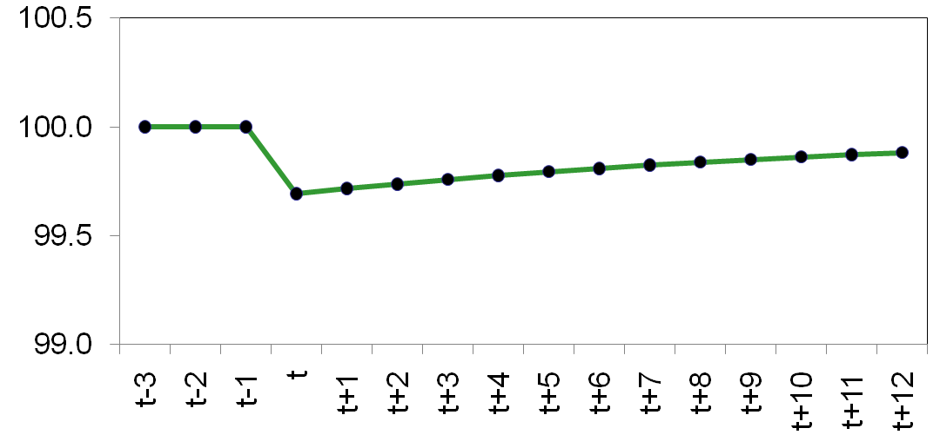
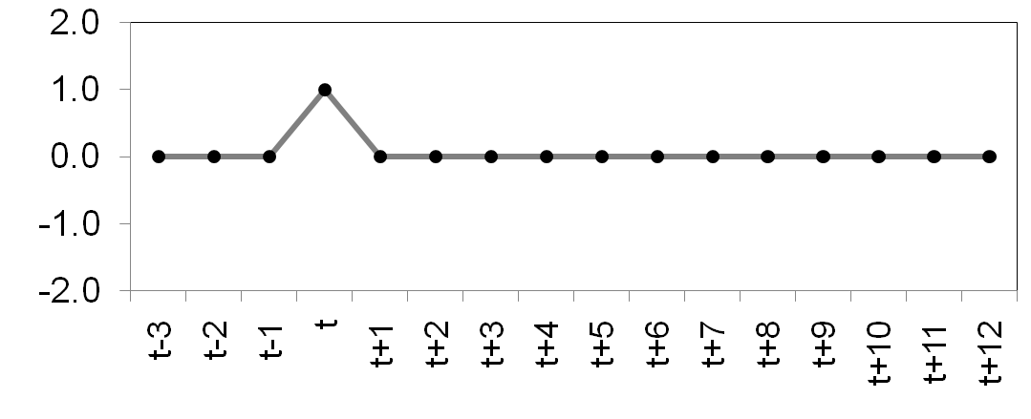
The dynamic response to a supply shock
A one-period supply shock affects output for many periods.
Notes:
The behavior of output shown on this slide mirrors the behavior of output on the DAD-DAS graph a few slides back.

Slide 33
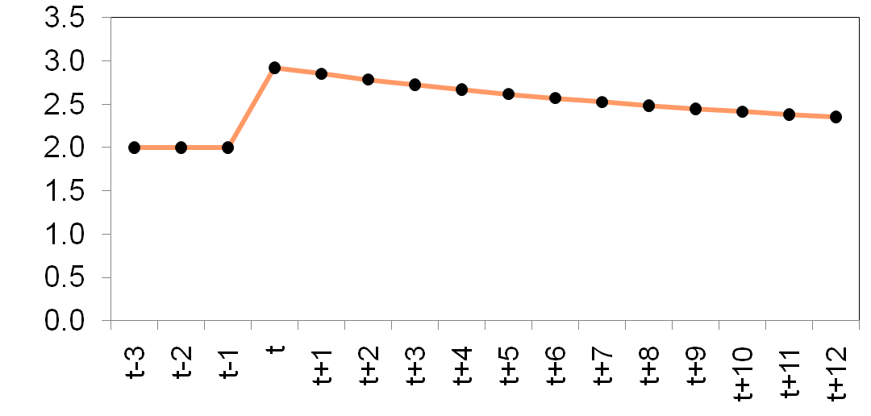
The dynamic response to a supply shock
Because inflation expect-ations adjust slowly, actual inflation remains high for many periods.
Notes:
Similarly, the behavior of inflation shown here mirrors that depicted on the DAD-DAS graph a few slides back.

Slide 34
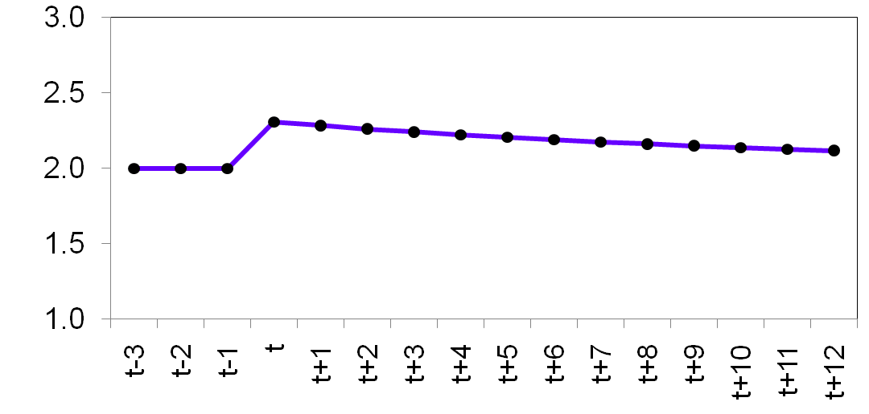
The dynamic response to a supply shock
The real interest rate takes many periods to return to its natural rate.
Notes:
When the shock causes inflation to rise, the central bank responds by raising the real and nominal interest rates. We see the real rate here. The nominal rate is shown on the following slide.
Over time, both move back toward their initial values.

Slide 35
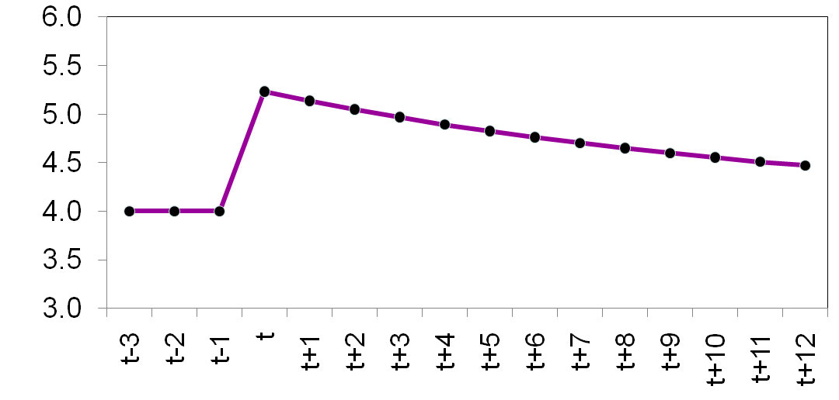
The dynamic response to a supply shock
The behavior of the nominal interest rate depends on that of the inflation and real interest rates.

Slide 36
A shock to aggregate demand
Period t: Positive demand shock (ε > 0) shifts DAD to the right; output and inflation rise.
Periods t + 2 to t + 4 : Higher inflation in previous period raises inflation expectations, shifts DAS up.
Inflation rises, output falls.
Period t + 1 : Higher inflation in t raised inflation expectations for t + 1, shifting DAS up.
Inflation rises more, output falls.
DAS_{t +5}
Period t – 1: initial eq’m at A
Period t + 5: DAS is higher due to higher inflation in preceding period, but demand shock ends and DAD returns to its initial position.
Eq’m at G.
Periods t + 6 and higher: DAS gradually shifts down as inflation and inflation expectations fall, economy gradually recovers until reaching LR eq’m at A.
π
Y
DAS_{t +4}
DAS_{t +3}
F
G
DAS_{t +2}
π_{t + 5}
E
D
DAS_{t + 1}
C
DAS_{t -1,t}
π_{t}
B
π_{t – 1}
A
DAD_{t ,t+1,…,t+4}
DAD_{t -1, t+5}
Y
Y_{t + 5}
Y_{t –1}
Y_{t}
Notes:
This slide presents the experiment described on pp.458-460 of the text.

Slide 37
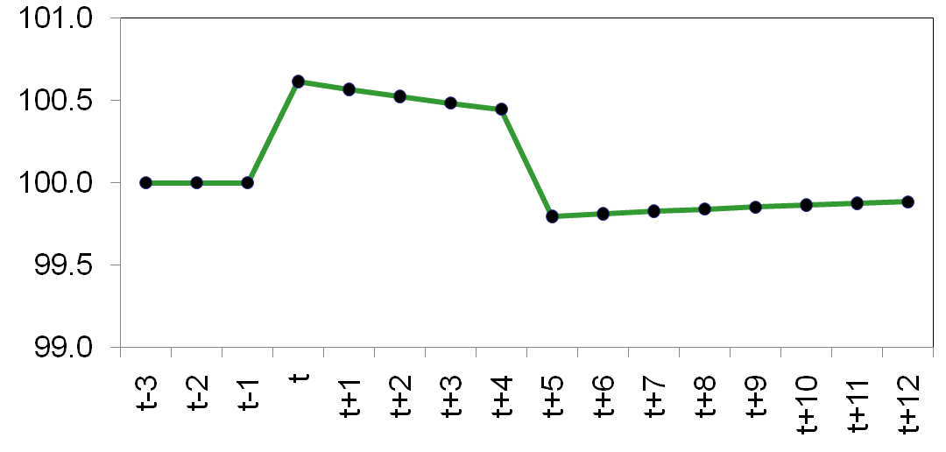
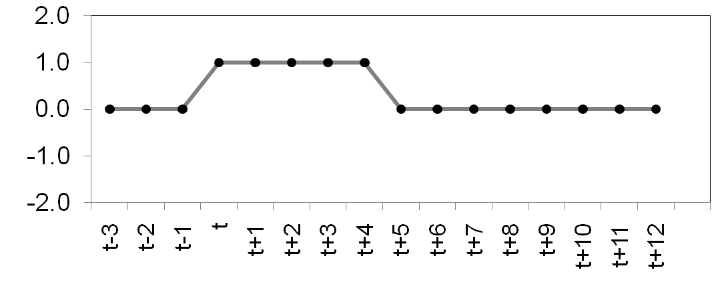
The dynamic response to a demand shock
The demand shock raises output for five periods. When the shock ends, output falls below its natural level and recovers gradually.

Slide 38
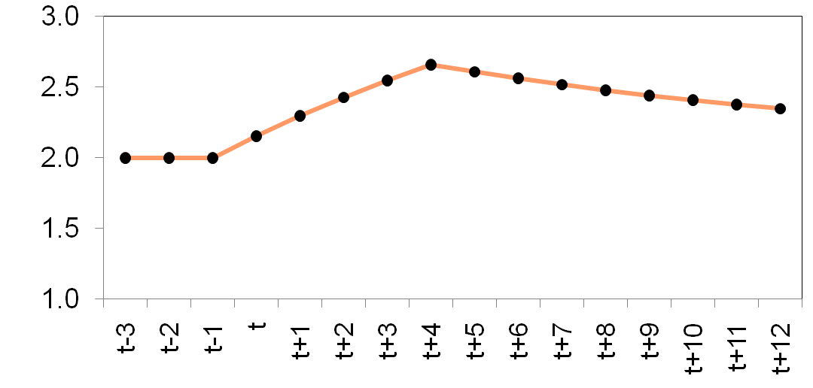
The dynamic response to a demand shock
The demand shock causes inflation to rise.
When the shock ends, inflation gradually falls toward its initial level.

Slide 39
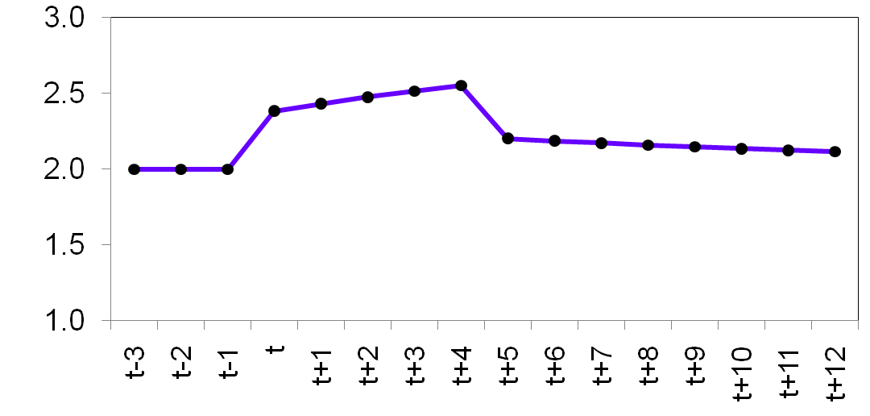
The dynamic response to a demand shock
The demand shock raises the real interest rate.
After the shock ends, the real interest rate falls and approaches its initial level.

Slide 40
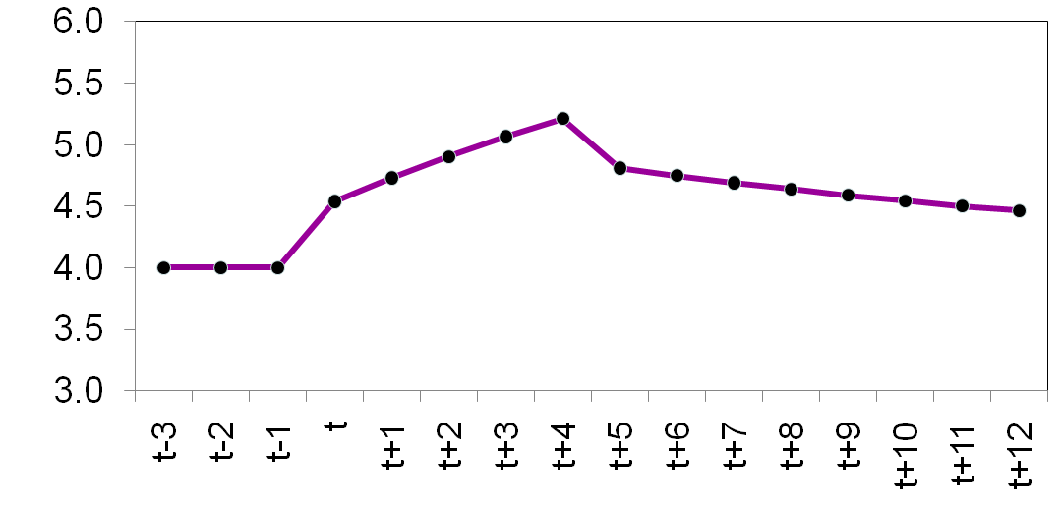
The dynamic response to a demand shock
The behavior of the nominal interest rate depends on that of the inflation and real interest rates.

Slide 41
A shift in monetary policy
Period t – 1: target inflation rate π* = 2%, initial eq’m at A
Subsequent periods: This process continues until output returns to its natural rate and inflation reaches its new target.
Period t: Central bank lowers target to π* = 1%, raises real interest rate, shifts DAD leftward. Output and inflation fall.
π
Y
Period t + 1 : The fall in π_{t}
reduced inflation expectations for t + 1, shifting DAS downward. Output rises, inflation falls.
DAS_{t -1, t}
A
DAS_{t +1}
π_{t – 1} = 2%
π_{t}
B
C
DAS_{final}
π_{final} = 1%
Z
DAD_{t – 1}
DAD_{t, t + 1,…}
Y
Y_{t}
, Y_{final}
Y_{t –1}
Notes:
This slide presents the experiment described on pp.460-463 of the text.

Slide 42
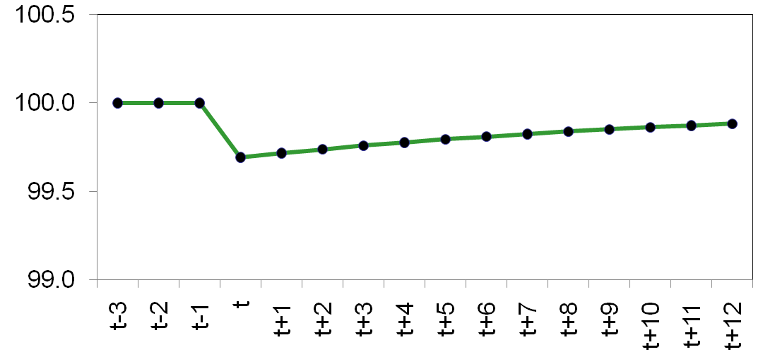
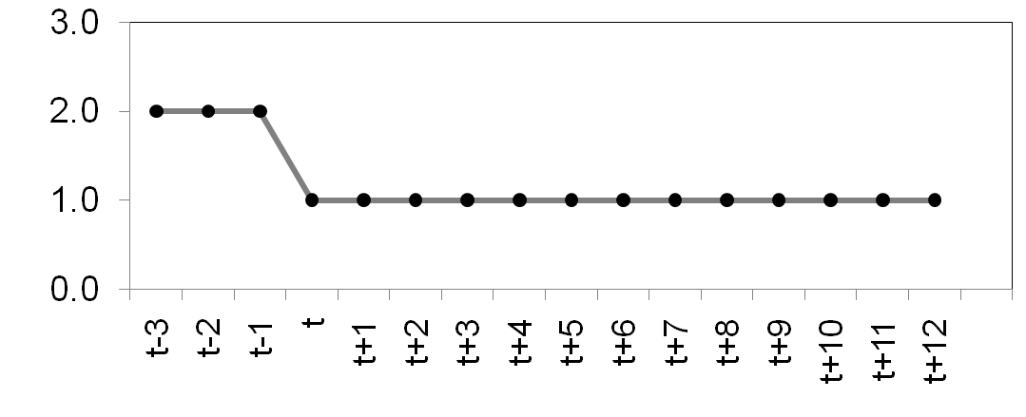
The dynamic response to a reduction in target inflation
Reducing the target inflation rate causes output to fall below its natural level for a while.
Output recovers gradually.
Notes:
The lower graph illustrates an important concept in macroeconomics:
a central bank can permanently lower inflation by inducing a recession.

Slide 43
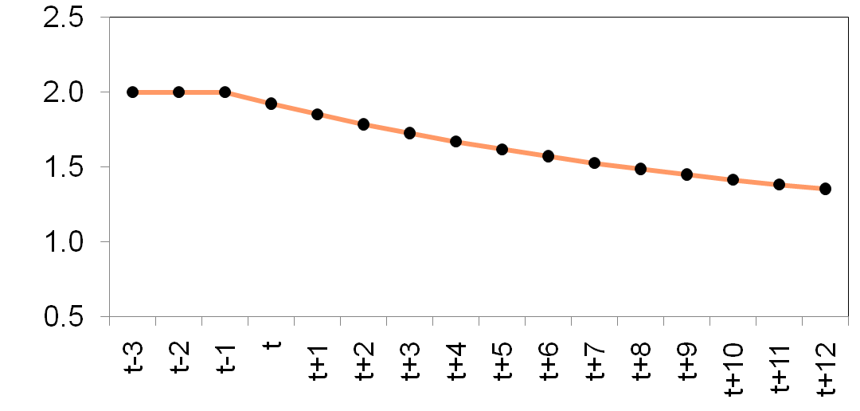
The dynamic response to a reduction in target inflation
Because expect-ations adjust slowly, it takes many periods for inflation to reach the new target.
Notes:
The sluggish behavior of inflation results from our assumption that expectations are adaptive.

Slide 44
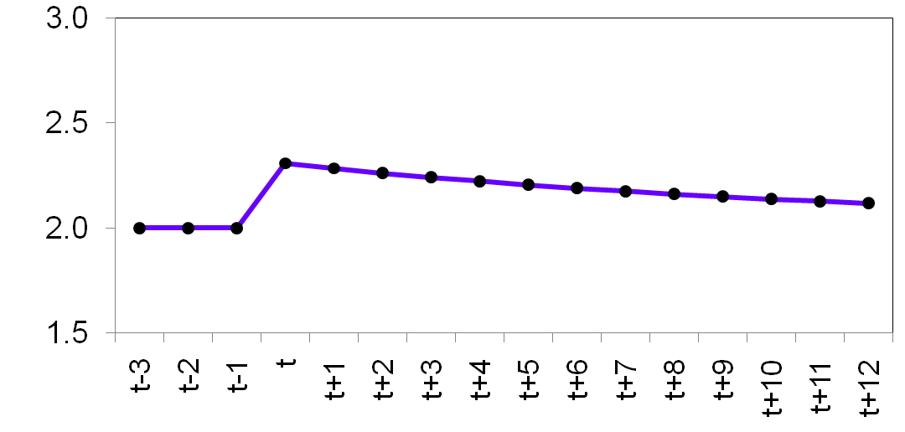
The dynamic response to a reduction in target inflation
To reduce inflation, the central bank raises the real interest rate to reduce aggregate demand.
The real interest rate gradually returns to its natural rate.

Slide 45
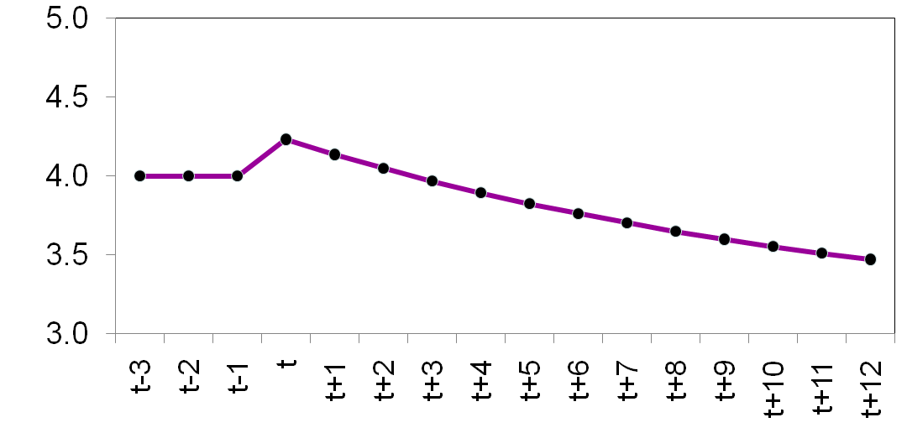
The dynamic response to a reduction in target inflation
The initial increase in the real interest rate raises the nominal interest rate.
As the inflation and real interest rates fall, the nominal rate falls.

Slide 46
APPLICATION: Output variability vs. inflation variability
A supply shock reduces output (bad) and raises inflation (also bad).
The central bank faces a tradeoff between these “bads” – it can reduce the effect on output, but only by tolerating an increase in the effect on inflation….
Notes:
This and the following two slides correspond to the first half of Section 15-4, pp.463-466.

Slide 47
APPLICATION: Output variability vs. inflation variability
CASE 1: θ_{π} is large, θ_{Y} is small
π
A supply shock shifts DAS up.
In this case, a small change in inflation has a large effect on output, so DAD is relatively flat.
DAS_{t}
π_{t}
DAS_{t – 1}
π_{t –1}
The shock has a large effect on output but a small effect on inflation.
DAD_{t – 1, t}
Y
Y_{t}
Y_{t –1}
Notes:
Most students can readily see that the slope of the DAD curve determines the relative magnitudes of the effects on output vs. inflation.
What is less obvious is the relation between the theta parameters and DAD’s slope. You can convince students of the relationship using intuition and using math:
Intuition: Large θ_{π} and small θ_{Y} means the central bank is more concerned with keeping inflation close to its target than with keeping output (and hence employment) close to their natural rates. Thus, a small change in inflation will induce the central bank to more sharply raise the real interest rate, causing a significant drop in the quantity of goods demanded.
Math: In the equation for the DAD curve, output appears on the left-hand side, while inflation is on the right. The coefficient on inflation is a ratio that contains θ_{π} in the numerator and θ_{Y} in the denominator. Other things equal, an increase in θ_{π} or a decrease in θ_{Y} will increase this coefficient. Of course, the coefficient is NOT the slope of the DAD curve (because output, not inflation, is on the left-hand side); it is the inverse of the slope of the DAD. Hence, if this coefficient is large, the slope of DAD is small, and the DAD curve is relatively flat, as depicted here.

Slide 48
APPLICATION: Output variability vs. inflation variability
CASE 2: θ_{π} is small, θ_{Y} is large
π
In this case, a large change in inflation has only a small effect on output, so DAD is relatively steep.
DAS_{t}
π_{t}
DAS_{t – 1}
π_{t –1}
Now, the shock has only a small effect on output, but a big effect on inflation.
DAD_{t – 1, t}
Y
Y_{t}
Y_{t –1}
Notes:
In this case, the DAD curve is steep.
Intuition: Small θ_{π} and large θ_{Y} mean the central bank is more concerned with maintaining full employment output than with keeping inflation close to its target. Thus, even if inflation rises a lot, the central bank won’t raise the real interest rate very much, so demand for goods and services won’t fall very much.
Math: see explanation in “notes” section of preceding slide.
The textbook (pp.466-467) includes a nice case study comparing the priorities of the U.S.’ Federal Reserve with those of the European Central Bank. CASE 1 better fits the recent behavior of the ECB, while CASE 2 better fits the Fed’s recent behavior.

Slide 49
APPLICATION: The Taylor principle
The Taylor principle (named after John Taylor): The proposition that a central bank should respond to an increase in inflation with an even greater increase in the nominal interest rate (so that the real interest rate rises).
I.e., central bank should set θ_{π} > 0.
Otherwise, DAD will slope upward, economy may be unstable, and inflation may spiral out of control.
Notes:
This and the next few slides summarize the second half of Section 15-4, pp.467-469.
Looking at the equation for DAD, the sign of the coefficient on inflation is the opposite of the sign of θ_{π}.

Slide 50
APPLICATION: The Taylor principle
(DAD)
(MP rule)
If θ_{π} > 0:
When inflation rises, the central bank increases the nominal interest rate even more, which increases the real interest rate and reduces the demand for goods & services.
DAD has a negative slope.

Slide 51
APPLICATION: The Taylor principle
(DAD)
(MP rule)
If θ_{π} < 0:
When inflation rises, the central bank increases the nominal interest rate by a smaller amount. The real interest rate falls, which increases the demand for goods & services.
DAD has a positive slope.

Slide 52
APPLICATION: The Taylor principle
If DAD is upward-sloping and steeper than DAS, then the economy is unstable: output will not return to its natural level, and inflation will spiral upward (for positive demand shocks) or downward (for negative ones).
Estimates of θ_{π} from published research:
θ_{π} = –0.14 from 1960–78, before Paul Volcker became Fed chairman. Inflation was high during this time, especially during the 1970s.
θ_{π} = 0.72 during the Volcker and Greenspan years. Inflation was much lower during these years.
Notes:
These estimates of θ_{π} help explain why inflation was out of control during the 1970s but came back under control with Paul Volcker and the change in monetary policy.
See the Case Study on pp.470-471 for more information about the estimates of θ_{π} and their implications.

Slide 53
CHAPTER SUMMARY
The DAD-DAS model combines five relationships: an IS-curve-like equation of the goods market, the Fisher equation, a Phillips curve equation, an equation for expected inflation, and a monetary policy rule.
The long-run equilibrium of the model is classical. Output and the real interest rate are at their natural levels, independent of monetary policy. The central bank’s inflation target determines inflation, expected inflation, and the nominal interest rate.
52

Slide 54
CHAPTER SUMMARY
The DAD-DAS model can be used to determine the immediate impact of any shock on the economy and can be used to trace out the effects of the shock over time.
The parameters of the monetary policy rule influence the slope of the DAS curve, so they determine whether a supply shock has a greater effect on output or inflation. Thus, the central bank faces a tradeoff between output variability and inflation variability.
53

Slide 55
CHAPTER SUMMARY
The DAD-DAS model assumes that the Taylor principle holds, i.e. that the central bank responds to an increase in inflation by raising the real interest rate. Otherwise, the economy may become unstable and inflation may spiral out of control.
54

